Slide 1

DATA ENGINEERING 1
TRADEOFFS OF DATA ARCHITECTURES
Laszlo Sallo
OCTOBER 2024

Slide 2






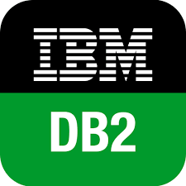

DATA LANDSCAPE BEFORE 2010

Slide 3
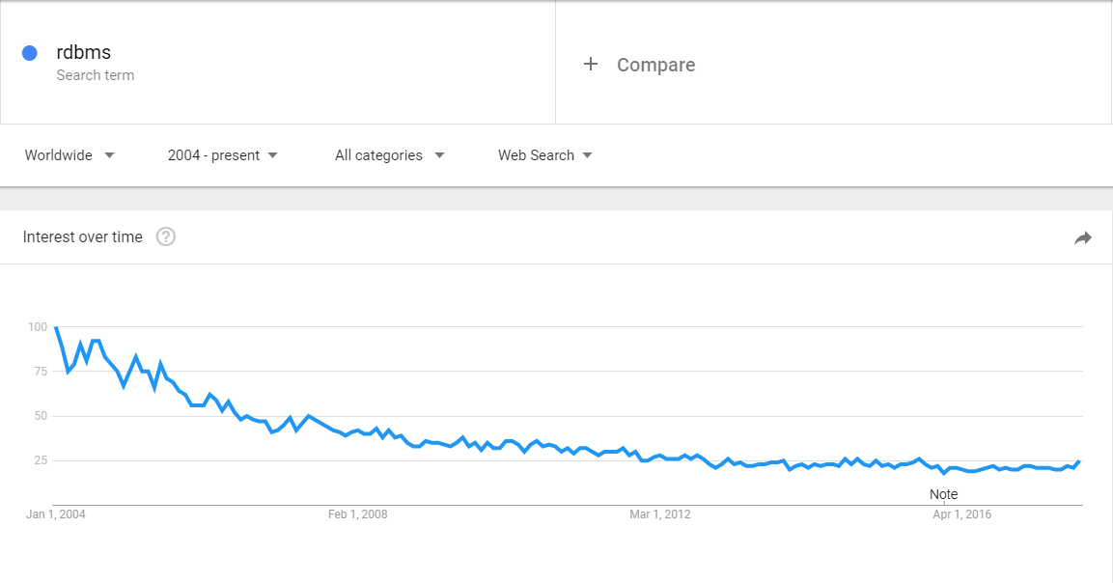
RDBMS

Slide 4
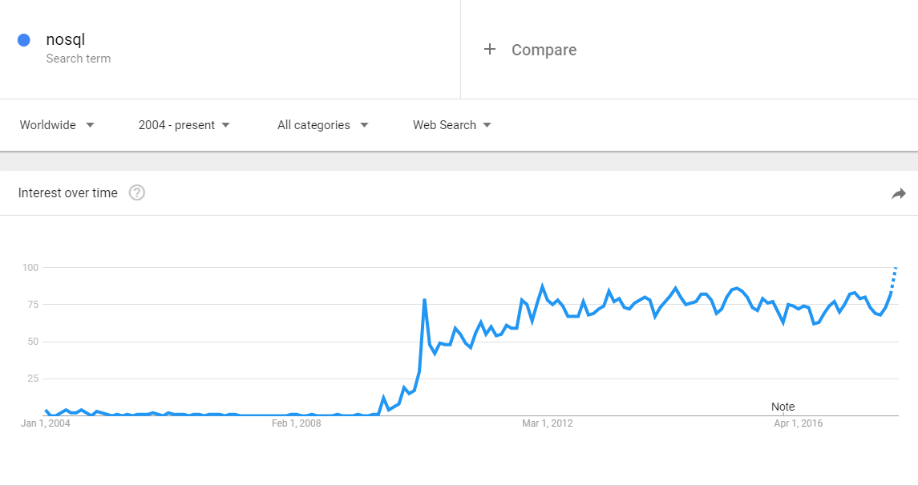
NOSQL

Slide 5
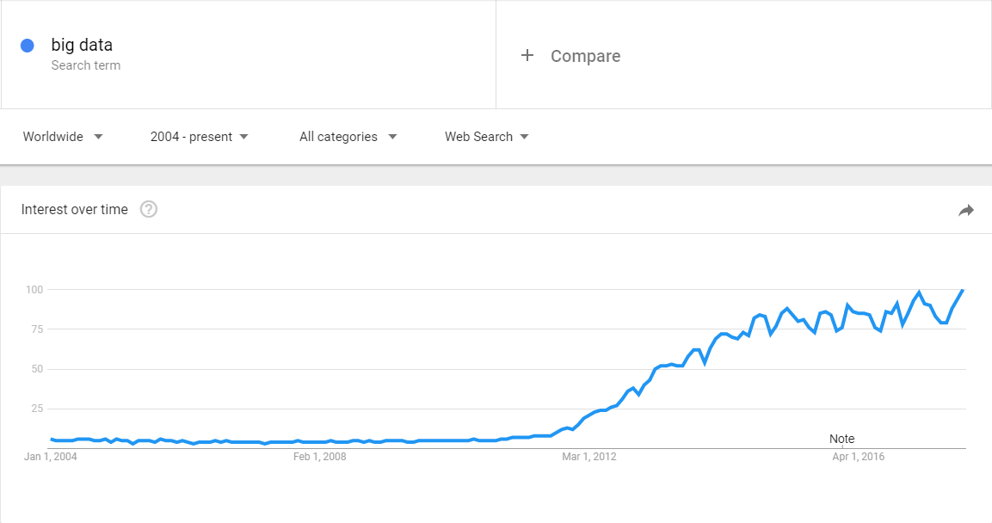
BIG DATA

Slide 6

DATA SYSTEM REVOLUTION IN LATE 2000’S

Slide 7
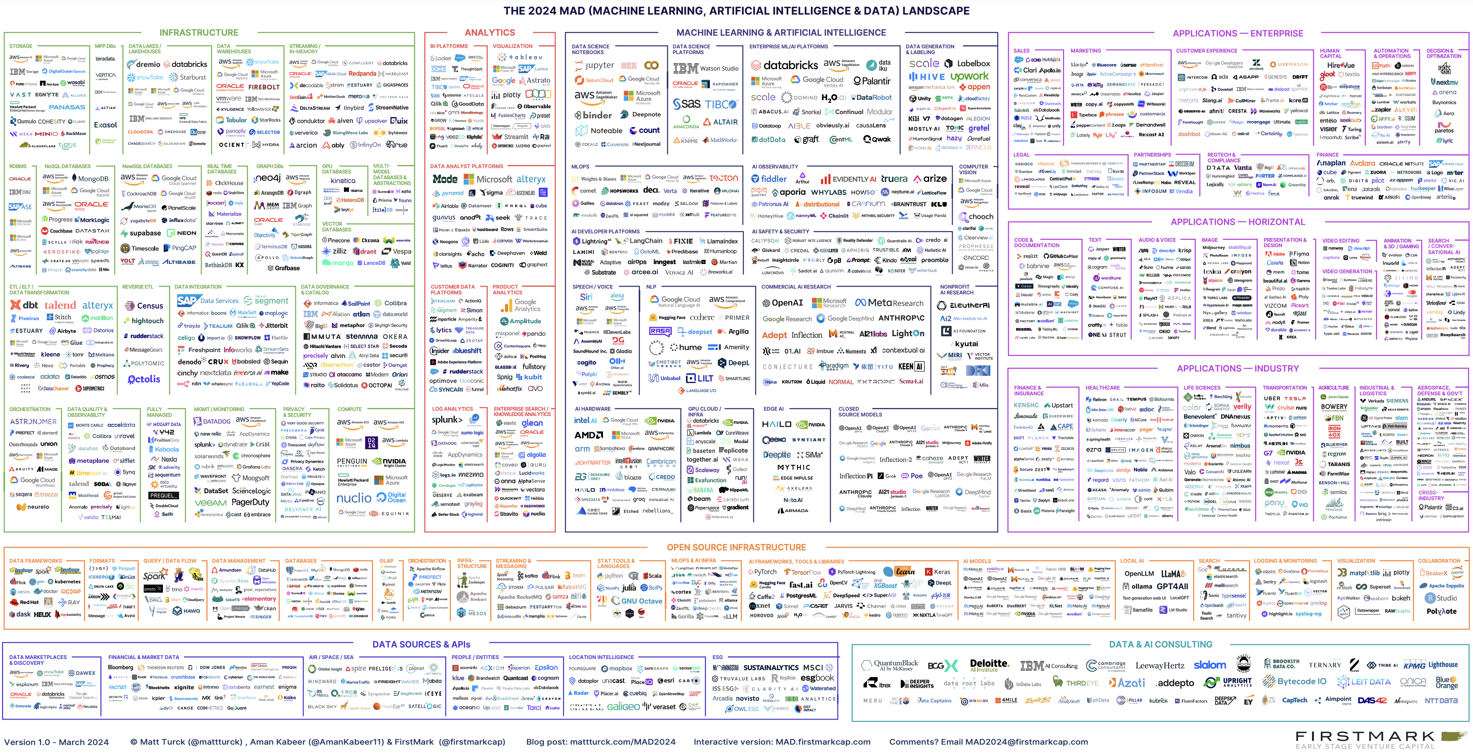

Slide 8



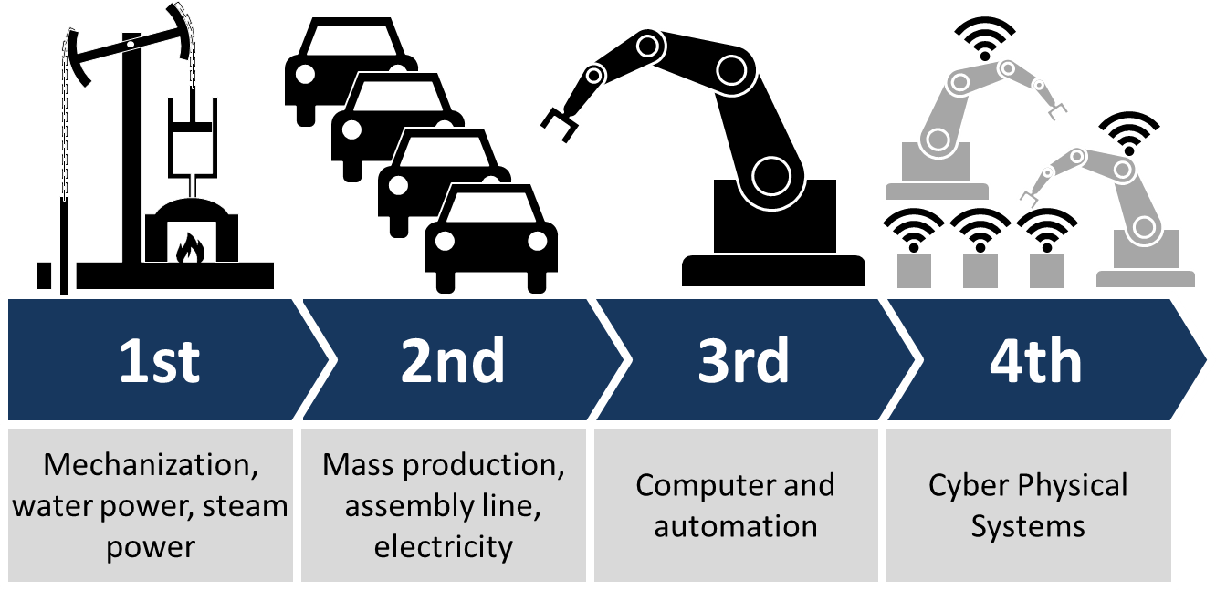
CATALYSTS OF CHANGE
SOCIAL MEDIA
MOBILITY
DIGITAL TRANSFORMATION
IoT / INDUSTRY 4.0

Slide 9

CHANGE AGENT
STARTUPS

Slide 10
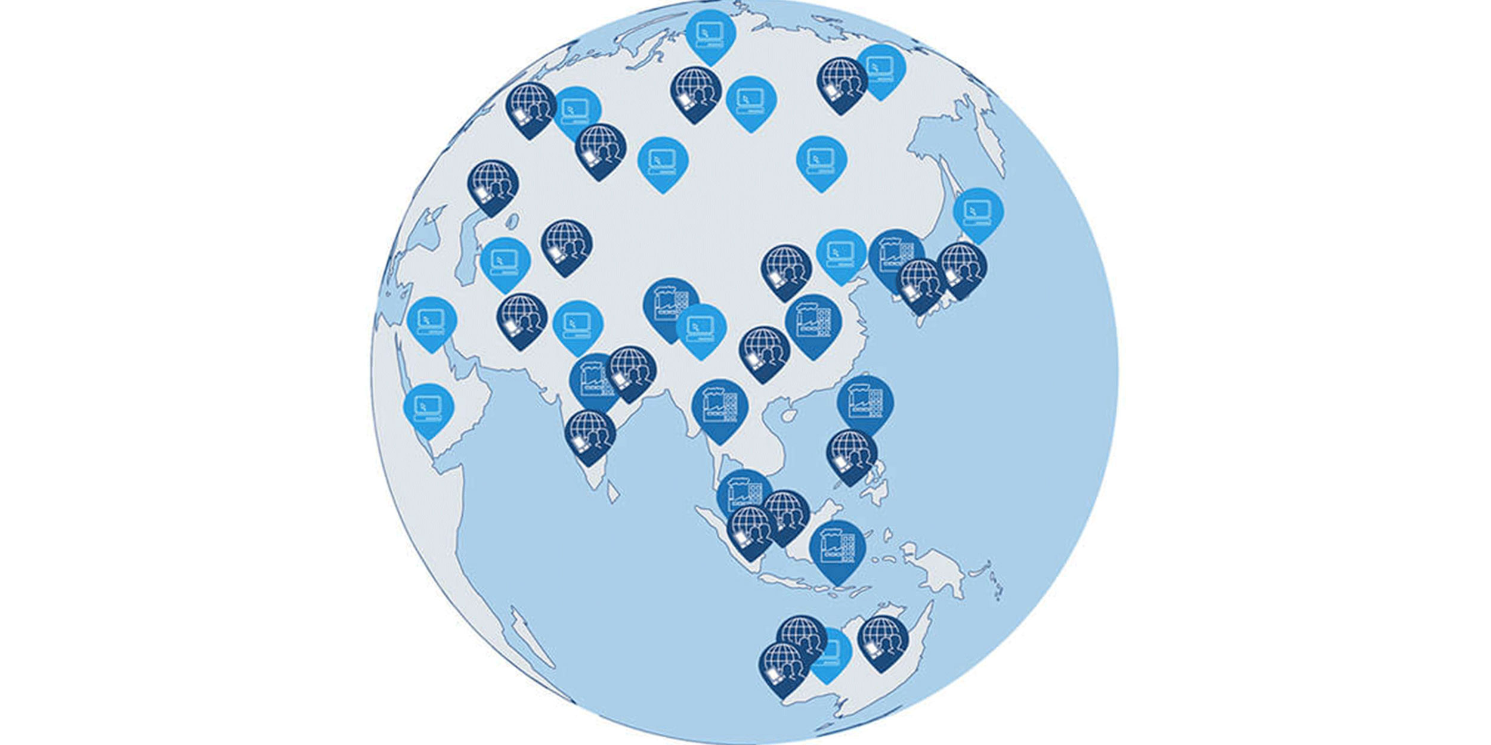
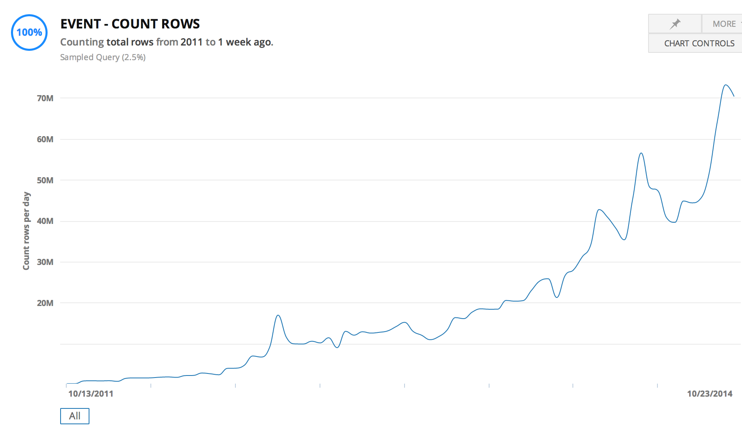

STARTUPS
GLOBAL ENTERPRISE
WITH HYPER SCALE CAPACITY

Slide 11



CHANGE AGENT
OPEN SOURCE SOFTWARE IS SOFTWARE WITH SOURCE CODE THAT ANYONE CAN
INSPECT,
MODIFY,
OR ENHANCE.

Slide 12
COST OF STORAGE / COST OF COMPUTATION
1 Gigabyte
$2.64 billion in 1965
$0.014 in 2024

Slide 13
THE CHANGE
SOLUTIONS for
real time + highly available + large DATA
in
economically feasible way
Notes:
Automated cars
Real-time bidding (RTB)
Stock exchange
Telemedicine
Blockchain

Slide 14
THE FIRST IDEA: DISTRIBUTED SYSTEMS

Slide 15


SERVER – CLIENT ARCHITECTURE
CLIENT
CLIENT
CLIENT
SERVER

Slide 16
SCALING
CLIENT
CLIENT
CLIENT
VERTICAL
SCALING
SERVER

Slide 17

DISTRIBUTED SYSTEMS
CLIENT
CLIENT
CLIENT
HORIZONTAL
SCALING
SERVER CLUSTER
NODE 1
NODE 2
NODE 3
NODE 4

Slide 18
HORIZONTAL SCALING - REPLICATION
CLIENT
CLIENT
CLIENT
REPLICATION
SCALE ONLY FOR PERFORMANCE
LOAD BALANCER
SERVER CLUSTER
COMPANY
DATA
COMPANY
DATA
COMPANY
DATA
COMPANY
DATA

Slide 19
HORIZONTAL SCALING - PARTITIONING
CLIENT
CLIENT
CLIENT
PARTITIONING
HAVE TO KNOW WHERE TO GO
UNBALANCED
PROXY
SERVER CLUSTER
COMPANY
EUROPE
DATA
COMPANY
AMERICA
DATA
COMPANY
ASIA
DATA
COMPANY
AFRICA
DATA

Slide 20
HORIZONTAL SCALING - SHARDING
CLIENT
CLIENT
CLIENT
SHARDING
CAN BE SLOW
AGGREGATOR
SERVER CLUSTER
COMPANY
DATA A
COMPANY
DATA B
COMPANY
DATA C
COMPANY
DATA D

Slide 21
BARE METAL SERVER
ISSUES
COSTLY
COMPLICATED
HARD TO SCALE

Slide 22
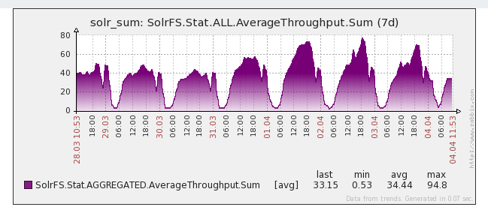
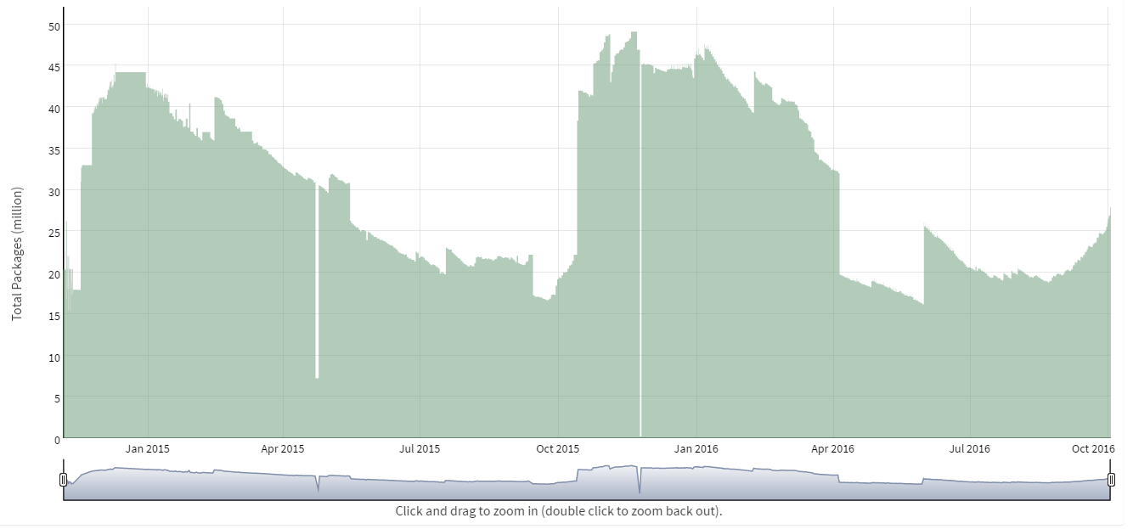
USE CASE
SEASONALITY OF REQUESTS (DAY)
SEASONALITY OF DATA SIZE (YEAR)

Slide 23
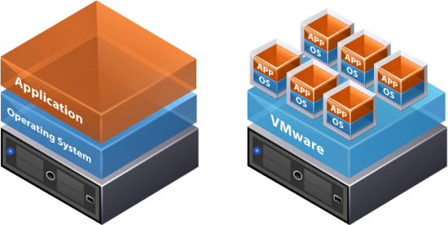
THE NEXT IDEA: TENANTS
RESOURCE RENTING (DATA CENTERS) DYNAMIC RESOURCE ALLOCATION (VIRTUALIZATION)

Slide 24
VIRTUALIZATION
ISSUES
COSTLY
COMPLICATED
HARD TO SCALE
SECURITY: PRIVATE VS PUBLIC

Slide 25

THE NEXT IDEA: CLOUD

Slide 26
USE CASE - AMAZON
…
5% utilized
NODE 1
NODE 2
NODE 3
NODE 4

Slide 27

CLOUD
2006

Slide 28
WHAT IS CLOUD?
A PIECE OF SOFTWARE WHICH OFFERS:
TOOLS TO REMOTELY AND SIMPLY HANDLE
VIRTUAL HARDWARE AND/OR SOFTWARE.

Slide 29
FURTHER BENEFITS
XAAS
IAAS – Infrastructure as a service
PAAS – Platform as a service
STAAS – Storage as a service
SAAS – Software as a service
DAAS – Database as a services
Serverless

Slide 30



CLOUD PROVIDERS

Slide 31

THE NEXT IDEA: BUILD NEW TOOLS

Slide 32
RDBMS IN A NEW PERSPECTIVE
RDBMS
= DESIGNED FOR OPERATIONS
= DESIGNED TO BE PERFECT IN EVERY SITUATION

Slide 33
CHARACTERISTICS OF RDBMS
Consistency is always guaranteed
Consistency over availability
Fully available or not available at all
…
FOR MORE READ ABOUT: ACID & CAP
Notes:
Consistency: Availability correlates with revenue and consistency generally does not.
Availability: partial availably ?
100% PERFECT
= $$$$$

Slide 34
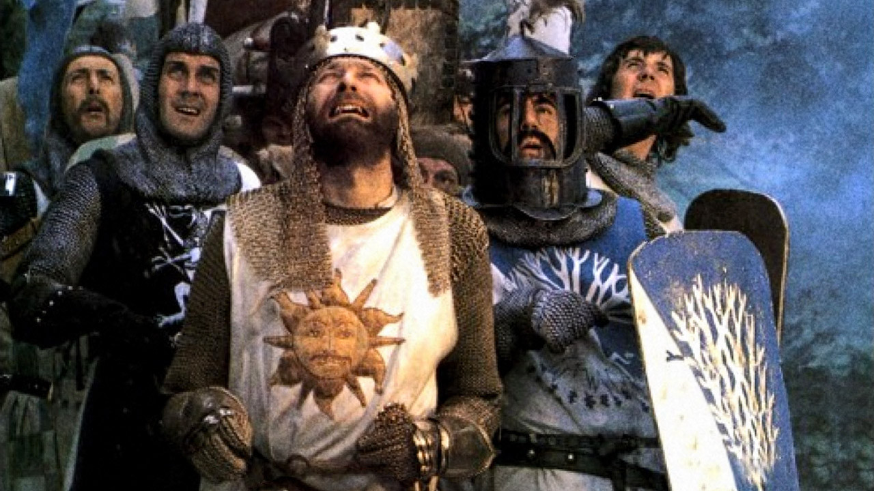
DO WE REALLY NEED RDBMS PERFECTION?

Slide 35
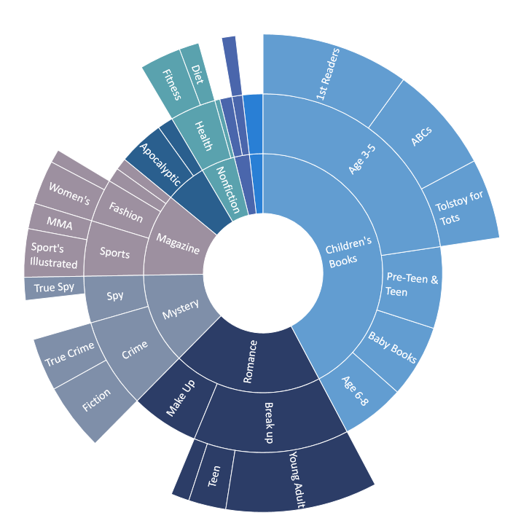
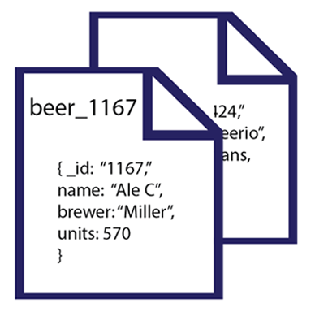
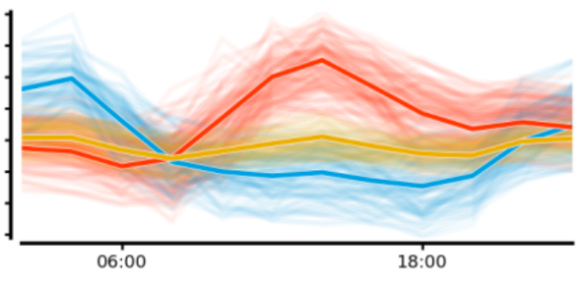
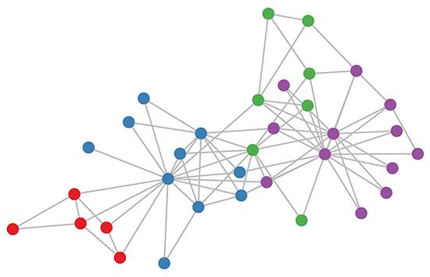
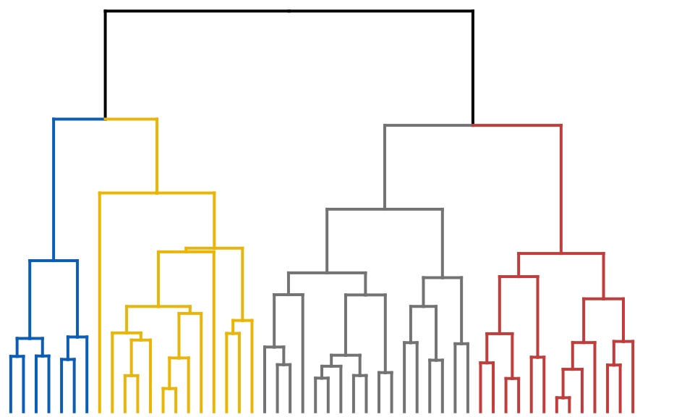
CAN WE GO BEYOND TABULAR DATA?

Slide 36
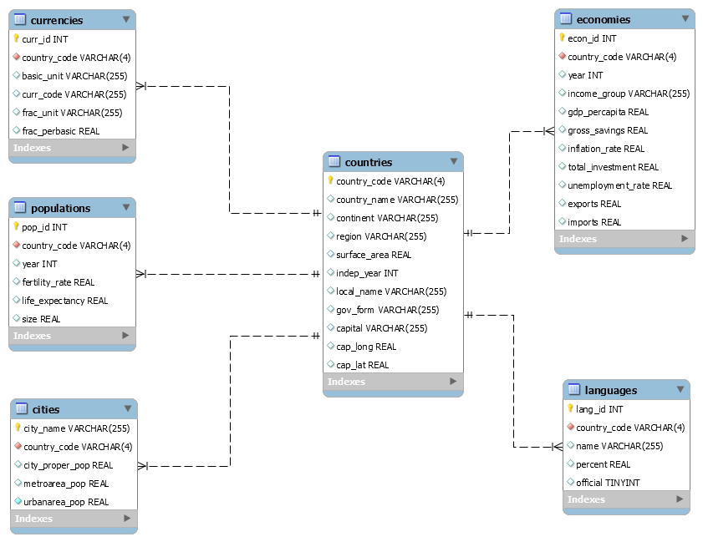
DO WE NEED THOSE RIGID SCHEMAS?

Slide 37


SPECIALIZED
NEW TOOLS
RDBMS

Slide 38
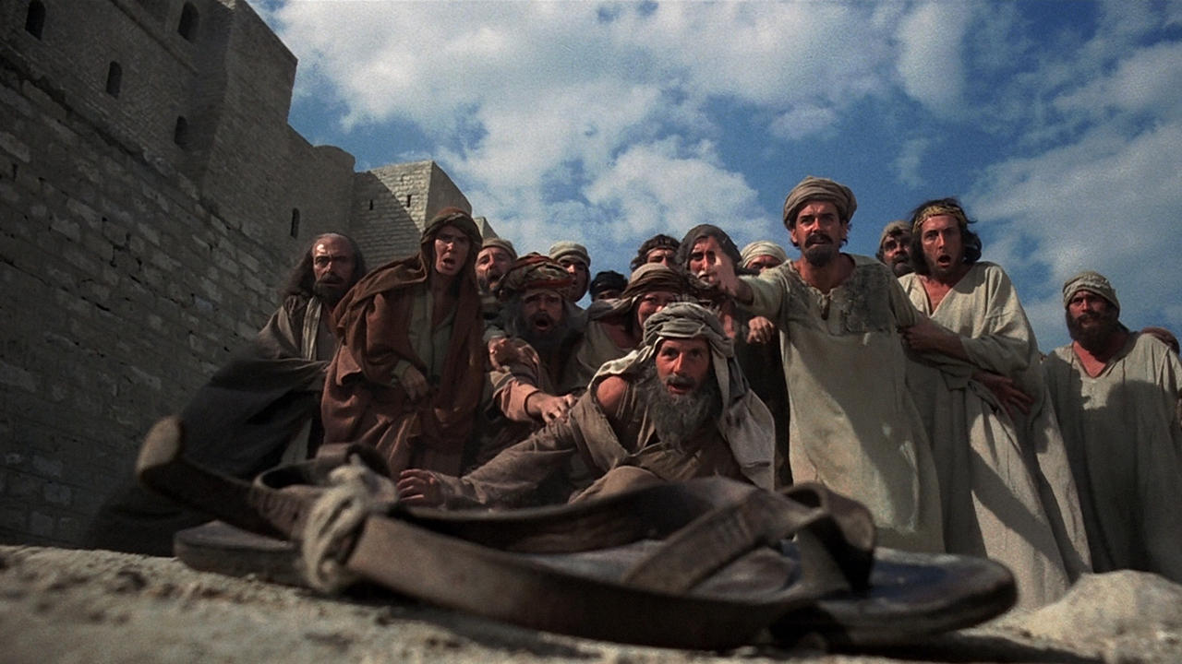
BIG DATA, NOSQL, …

